Slide 1
csci 45 – Assembly Lecture 8 - SIMD
Professor Kerney

Slide 2
Agenda
Midterm Review
Homework Review
Flynn’s Taxonomy
SIMD / NEON Overview

Slide 3
Midterm Review

Slide 4
Homework Review

Slide 5
Cray Supercomputers
“If you were plowing a field, which would you rather use: Two strong oxen or 1024 chickens?” -Cray
The early Crays got their performance by being “vector processors”, which means they were able to do multiply/add instructions across very wide vector fields.
In 1977, the Cray-1 had eight vector registers that were each 64x64-bit registers.
It was capable of doing 64 multiplies and 64 adds in the same # of cycles it took to multiply two numbers
If you could keep the vectors loaded (and your algorithm could do 64-wide operations), you could get tremendous performance.

Slide 6
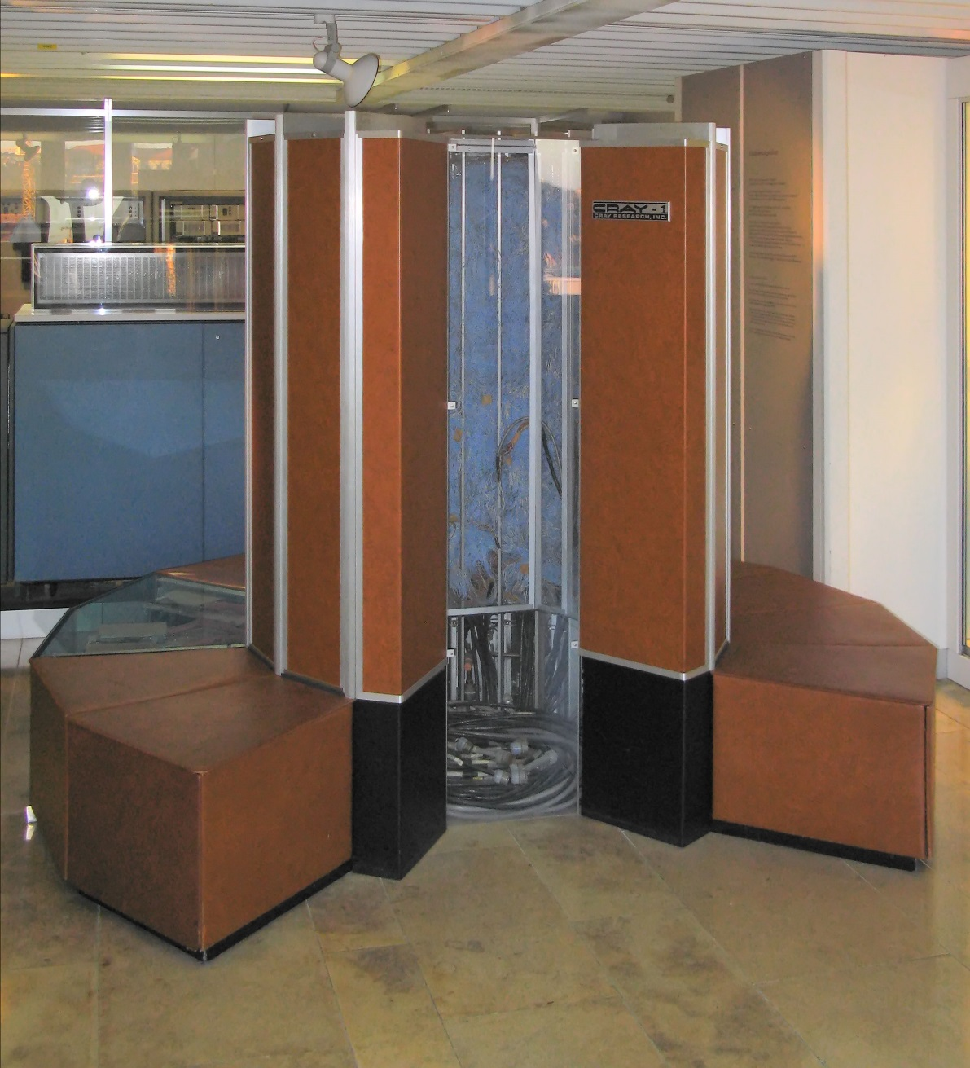
The Cray-1 (1977)

Slide 7
Cray Supercomputers
1977: Cray-1
20MHz, 2x80 MFLOPS, 8MB memory, $9M
1982: Cray-XMP
105MHz, 4x200 MFLOPS, 128MB, $15M
Had 1GB SSDs available at $1M each.
1988: Cray-YMP
167 MHz, 8x333 MFLOPS, 512MB, $30M, 2GB SSDs
Contrast: The Apple ][ had 1 MHz CPUs in ’77-’84 and 4k-64k RAM. In ‘88 they had 4 MHz and 128k-1MB RAM. They cost $1,300, give or take $600.
The 8-bit MOS 6502: 430 KMIPS, 1 general purpose register + 5 other registers (SP, PC, status flags, address, indexing).
RPI2: 500 MFLOPS; a modern i7 6700K: 113 GFLOPS

Slide 8
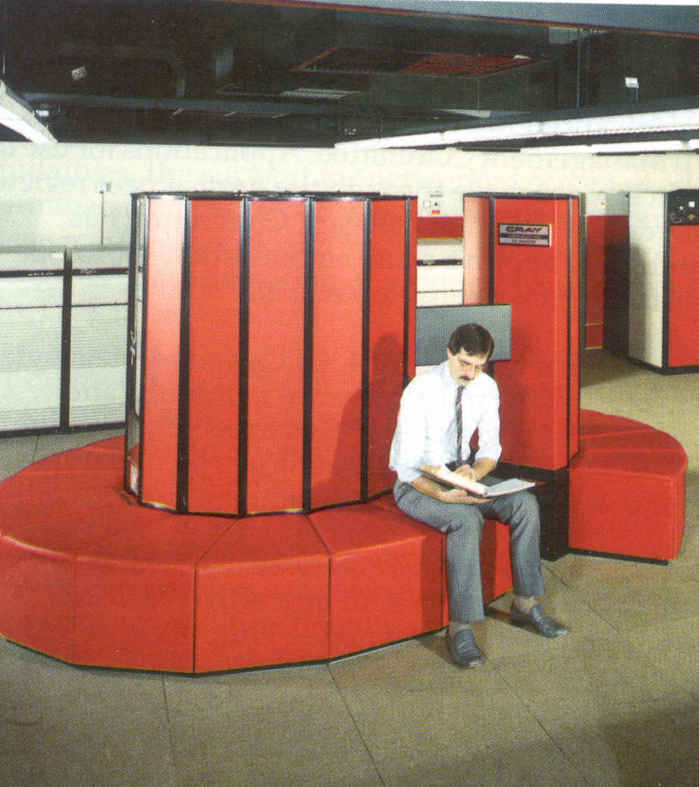
The Cray XMP (1982)

Slide 9
Flynn’s Taxonomy
Flynn’s Taxonomy is an old (1960s) view of computing that, like “Harvard Architecture”, is still semi-relevant today. Wikipedia Link
It categorizes all computers by how they answer these two questions:
Does the computer process one stream of instructions at a time, or can it do 2+ in parallel?
Does the computer have the ability to have one instruction work on one bit of data at a time, or can it work on 2+ in parallel?

Slide 10
Flynn’s Taxonomy - SISD
A computer that has a single instruction stream and a single data stream is your typical (old-school) CPU:
It runs one program at a time. In order to do multiprocessing, the OS swaps one program out and swaps another program in.
The program will load data into registers, add them together, store them, etc. I.e., one small chunk of data at a time is manipulated.

Slide 11
Flynn’s Taxonomy - SIMD
SIMD = Single Instruction, Multiple Data
SIMD means that one instruction can operate on multiple chunks of data at once. For example, “Multiply all registers from r0 through r7 by #10”
This comes up all the time in linear algebra – to multiply two matrices together involves doing the same multiply and adds over and over.
Or image processing, like darkening an image by 50%... you keep doing the same op over and over.
This can offer a massive performance boost.

Slide 12
Flynn’s Taxonomy - MISD
MISD is the least used of the 4 categories.
It is usually when you have multiple CPUs running on the same data stream at the same time, and they should all produce the same output.
Fault tolerant “voting” CPUs.
Suppose you’re in an Apollo rocket, and one CPU of your three says to engage thrusters. Should you?
What should you do if two of the three do?

Slide 13
Flynn’s Taxonomy - MIMD
MIMD is how modern CPUs work. Most desktop CPUs these days have multiple cores
Each core is basically its own SISD CPU, which runs its own instructions in parallel with the others.
You also have “hyperthreading” which lets a CPU appear to be multiple CPUs because individual programs rarely saturate a CPU’s functional units.
So it will run two programs at once, using register renaming to keep them from affecting the other.
Neither will have dependencies with the other!

Slide 14
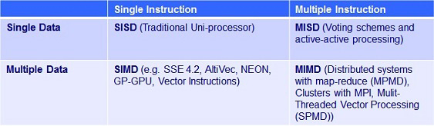
Flynn’s Taxonomy

Slide 15
SIMD Today
SIMD:“Single Instruction, Multiple Data”
These abilities that used to just be found in Cray supercomputers can now be found in cheap processors.
In Intel’s world, it is called SSE (Streaming SIMD Extensions) or MMX (Multimedia Extensions)
In ARM, it is called NEON (or rarely MPE – Media Processing Engine). We’ll learn NEON.

Slide 16

NEON GENESIS
NEON is pretty cool.
ARM’s introduction is here.
There is a popular anime based on it, as seen to the right...
It allows assembly programmers to greatly speed up their code when its amenable to SIMD processing.

Slide 17
NEON
NEON allows you to do one command on 64 (double width) or 128 bits (quad width) of virtual registers all at the same time.
You specify how the bits should be divvied up, for example, you could treat 128 bits like it was 4x32-bit registers, or 8x16-bit registers, and do a “multiply by 7” on each of them.
Neat fact: They don’t overflow into each other!
NEON gets its own set of registers (shared with the floating point processor, the VFP) so you can use them in addition to your regular registers!

Slide 18
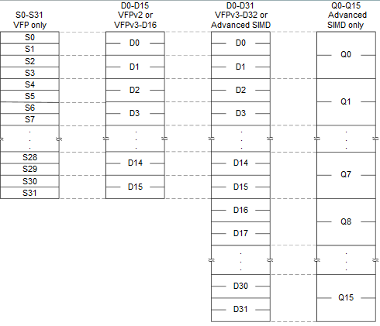
NEON Registers S = Single, D = Double, Q = Quad

Slide 19
NEON Assembly
Since the registers are all interchangeable, you need to specify which register you want with each command, as well as how it should be bit sliced with something like “.u8” (unsigned 8-bit)
For example, this will “vector load” (VLD) 128 bits (specified because we’re loading into a quad-word q0) from the address pointed to by R0, and will update R0 with R0 = R0 + 128:
vld1.u8 {q0}, [R0]!

Slide 20
NEON Assembly
This will do a “Vector Shift Right” on the q0 register, treating the 128 bits as if they were 16 different 8-bit registers (via the “.u8” suffix):
vshr.u8 q0,q0,#1
All the 8-bit values will shift right one bit, with the NEON pipeline automatically masking out the bits that shift off the right hand side, so they don’t percolate over to the next 8-bit “register”.

Slide 21
Complete NEON DARKEN
R0 holds *in, R1 holds *out, R3 holds memory address = R0 + (total bytes to process).
loop:
vld1.u8 {q0}, [R0]! @Load 128 bits from R0
vshr.u8 q0,q0,#1 @Shift 16x8 bits one to the right
vst1.u8 {q0}, [R1]! @Store 128 to R1
CMP R0, R3 @ If R0 < R3...
BLT loop @Keep going

Slide 22
d0-D1 == Q0; D2-D3 = Q1, etc.
Here’s identical code, implemented differently:
VLDMIA R0!,{d0-d3} @Load 256 bits into q0&q1
VSHR.U8 q0,q0,#1 @q0 = d0-d1
VSHR.U8 q1,q1,#1 @q1 = d2-d3
VSTMIA R1!,{d0-d3} @Save 256 bits into R1
Remember, the ! means writeback - update the pointer with the new calculated address.
VLDMIA means multiple vector load, can read into multiple registers at once.

Slide 23
Compiling with NEON
To compile your code using NEON, make sure your Makefile includes: -mfpu=neon
For both the assembly and g++
I have put a sample Makefile in /tmp/

Slide 24
More NEON Commands
vadd – vector add
vmul – vector multiply
vmla – vector multiply and accumulate
vshl – vector shift left
vabs – vector absolute value
vdup – set all sub variables to one value
vcvt – convert from float to int, etc.
vmovn – narrow all lanes from 16 to 8 bits, etc.
vand – vector logical AND

Slide 25
Shape Suffixes
Every NEON command comes with a suffix explaining how the 64 or 128 bit register should be treated. 8x8? 4x32? 2x64?
.U8 means “unsigned 8-bit”, which is what we’re using for our image processing code.
.S16 means “16-bit signed integer”
.S32, .U32, .S64, .U64 other options
.f32 means “single precision float”

Slide 26
Example Vector Float Add Source (a great reference)
loop:
vld1.32 {q0}, [r1]!
vld1.32 {q1}, [r2]!
vadd.f32 q0, q0, q1
subs r3, r3, #4
vst1.32 {q0}, [r0]!
bgt loop

Slide 27
NEON Intrinsics
You can also write NEON code directly from C
This is called “NEON Intrinsics”.
#include <arm_neon.h>
Performance really depends on the compiler. Sometimes it generates terrible code, sometimes it does really well. It’s for people scared of ASM.
For my code, intrinsics ran in 0.03s, which was just as fast as my hand-turned ASM code.
It’s actually easier and better just to write ASM.
Link for documentation

Slide 28
C Intrinsics Darken code
void darken(unsigned char *in,unsigned char *out, int width, int height) {
uint8x16_t foo; //Prepares a NEON register
for (int i = 0; i < width*height*3; i+=128) {
foo = vld1q_u8 (in+i); //Loads into it from *in
foo = vshrq_n_u8(foo,1); //Divide by 2
vst1q_u8 (out+i, foo); //Stores it into *out
}
return;
}

Slide 29
Automatically Vectorize
The compiler also has the ability to automatically detect places where vectorization can be useful.
You must have –mfpu=neon to use it still.
Enabled by default at –O3
or explicitly with -ftree-vectorize
g++ -O3 -mfpu=neon
Running time: 0.04s

Slide 30
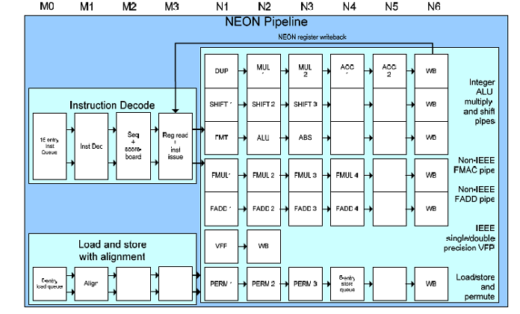
NEON PIPELINE

Slide 31
Accessing colors from the image array
You’ll see I wrote some C macros to make the code more readable. These show you how to pull out individual colors at a given (x,y) point.
const int stride = width * height;
#define R(i,j) (j*width+i)
#define G(i,j) (stride+j*width+i)
#define B(i,j) (stride+stride+j*width+i)
This converts to ASM easily, or you can use the C preprocessor with ASM if you rename it to be .S

Slide 32
Sepia toning
R = the red at some point; G = the green at that point; B = the blue at that point
R = 0.393*R + 0.769*G + 0.189*B
G = 0.349*R + 0.686*G + 0.168*B
B = 0.272*R + 0.534*G + 0.131*B
These values have to either be held as 16-bit values (to avoid overflow), or saturated 8-bit.

